Slide 1
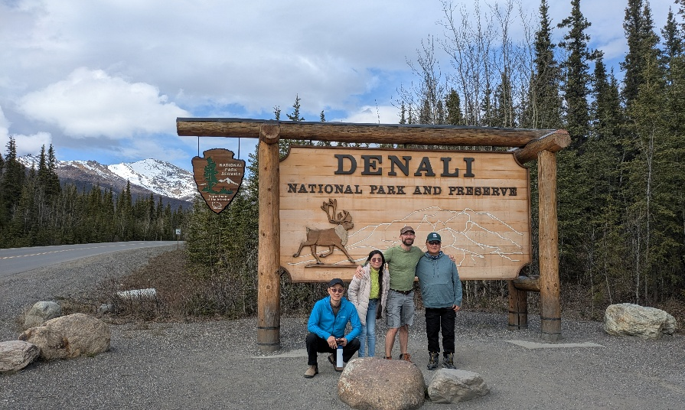
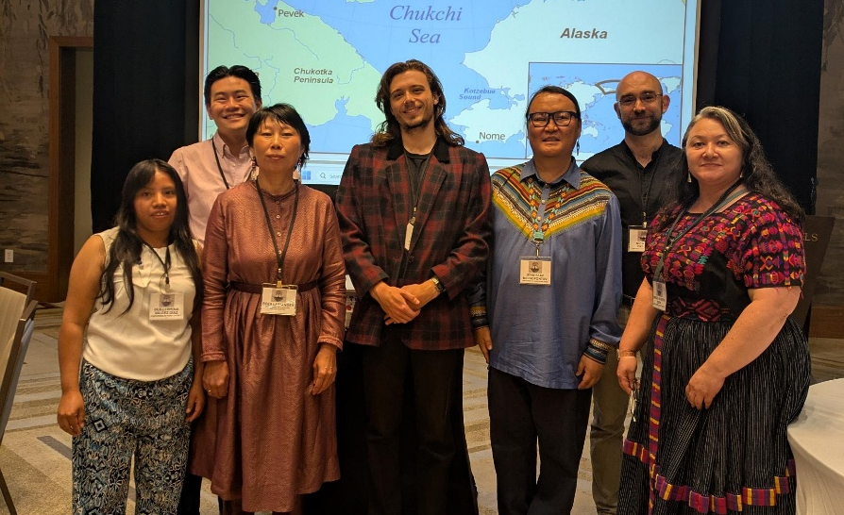
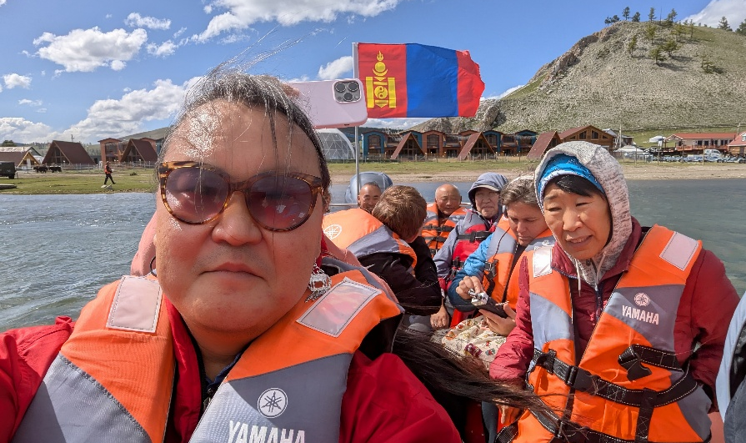
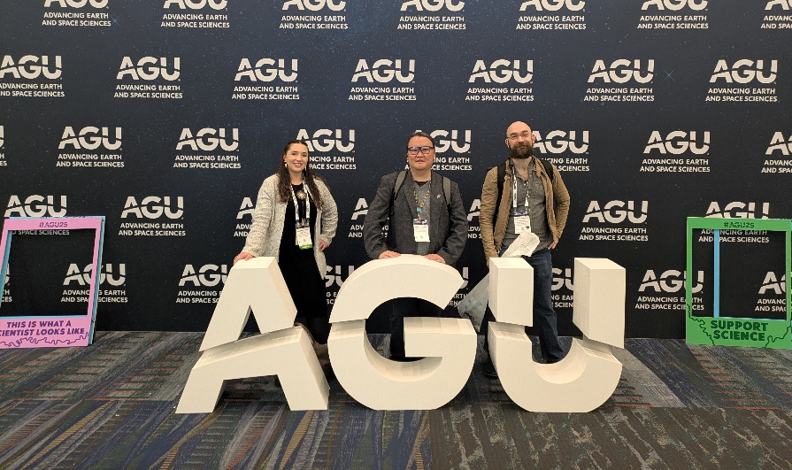
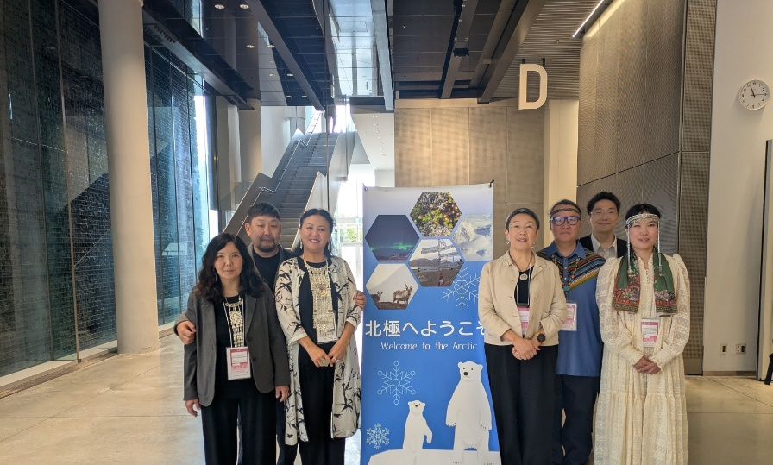
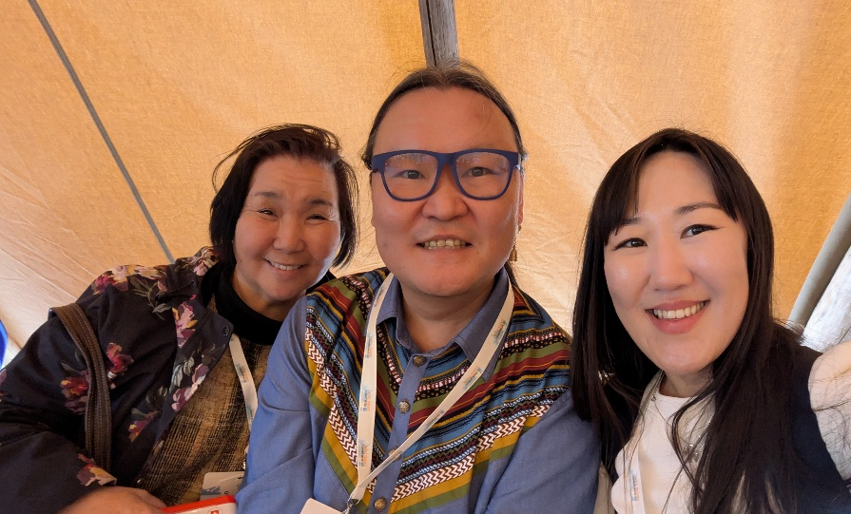
2025 Arctic research updates
Dr. Stanislav Saas Ksenofontov
ARCTICentre, UNI
Arctic Day
30 January 2026

Slide 2
Arctic research update
Projects involved in 2025
Continued involvement in “Frozen Commons” and “MUST” projects
A series of podcasts: 1) Fostering Indigenous-Led Research (speaker); 2) Conducting Research in Siberia (host), NNA CO
Training - Strategies toward Indigenous-led Research (ASSW), NNA CO
Indigenous pavilion at ASSW: Snowflake, Munkha, Traditional games
Workshop in Mongolia on art-science-Indigenous knowledge co-creation
URSA Major summer school in Fairbanks AK
NSF NNA CO Advisory Board Member and Facilitating Indigenous-Led Research Convergent Working Group Co-Lead

Slide 3
Arctic research update
Conferences attended in 2025
Arctic Science Summit Week, Boulder, CO (organized a session on Indigenization of Arctic research)
International Association for the Study of the Commons Conference, Amherst, MA
Native American and Indigenous Studies Association Conference, Oklahoma, OK (organized a session on Siberian research)
NYU Jordan Center Symposium "Post-Soviet Indigeneity Between Research and Resistance“, NYC
8th International Symposium on Arctic Research, Tokyo, Japan (organized a session on Sakha cosmologies and ecological knowledge)
American Geophysical Union Fall Meeting, New Orleans, LA

Slide 4
Arctic research update
Presentations given in 2025
On good terms: pathways to decolonizing science-appropriated Indigenous terminologies in Arctic research, ASSW 2025
Indigenous perspectives of sustainability in the context of global change: the case of Sakha, NE Siberia, ASSW 2025
Russian energy megaprojects: infrastructural violence against Arctic Indigenous communities, ASSW 2025
Infrastructural violence of Russian energy megaprojects against Arctic Indigenous communities, IASC 2025
Sustainability of Indigenous communities in the context of global change: perspectives from Sakha, NE Siberia, NAISA 2025
Sustainability of Indigenous Peoples in the context of global change: perspectives from Sakha Sire, NYU Symposium
On good terms: pathways to decolonizing science-appropriated Indigenous terminologies in Arctic research, ISAR8
On good terms: pathways to decolonizing science-appropriated Indigenous terminologies in Arctic research, AGU 2025

Slide 5
Arctic research update
Papers published and planned
Ksenofontov, S., Kuklina, V., Petrov, A., Kholodov, A. (2025) On good terms: pathways to decolonizing science-appropriated Indigenous terminologies in Arctic research, Arctic Science, 11, 1-9
Ksenofontov, S. (2026) Russian energy megaprojects: infrastructural violence against Indigenous communities in Sakha Sire, Cultural politics (accepted)
Ahmadzai, A., McIntyre S., Ksenofontov S. Co-opting Indigenous and Local Knowledge Systems: A Neoliberal Strategy of Epistemic Suppression, a book chapter (accepted)
Ksenofontov, S., Parlato, N., Laptander, R., Sharakhmatova V., Solovyeva V., Yang, B. Alaska and Siberia relations (in progress)

Slide 6
Arctic research update
Plans 2026
Projects:
A Pan-Arctic species list with Indigenous names (UZH, Switzerland)
Conferences:
Climate and Cryosphere Conference, Wellington, Aotearoa New Zealand, 8-12 February 2026 (Indigenous organizing committee and presenter)
American Association of Geographers Annual Meeting, San Francisco, CA, 17-21 March 2026 (speaker at the panel and presenter)
Arctic Science Summit Week, Aarhus, Denmark, 25 March – 01 April 2026 (Indigenous Pavilion committee, presenter and AOS participant)
UArctic Congress, Faroe Islands, Denmark, 26-29 May 2026 (session organizer and presenter)
Political Ecology Network Conference (POLLEN), Barcelona, Spain, 29 June – 3 July (online participation)
Papers:
Institutional violence? Food security?
Ongoing writing on Alaska and Siberia relations

Slide 7
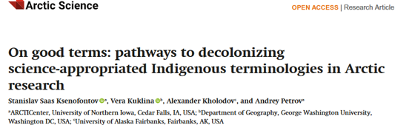

Slide 8
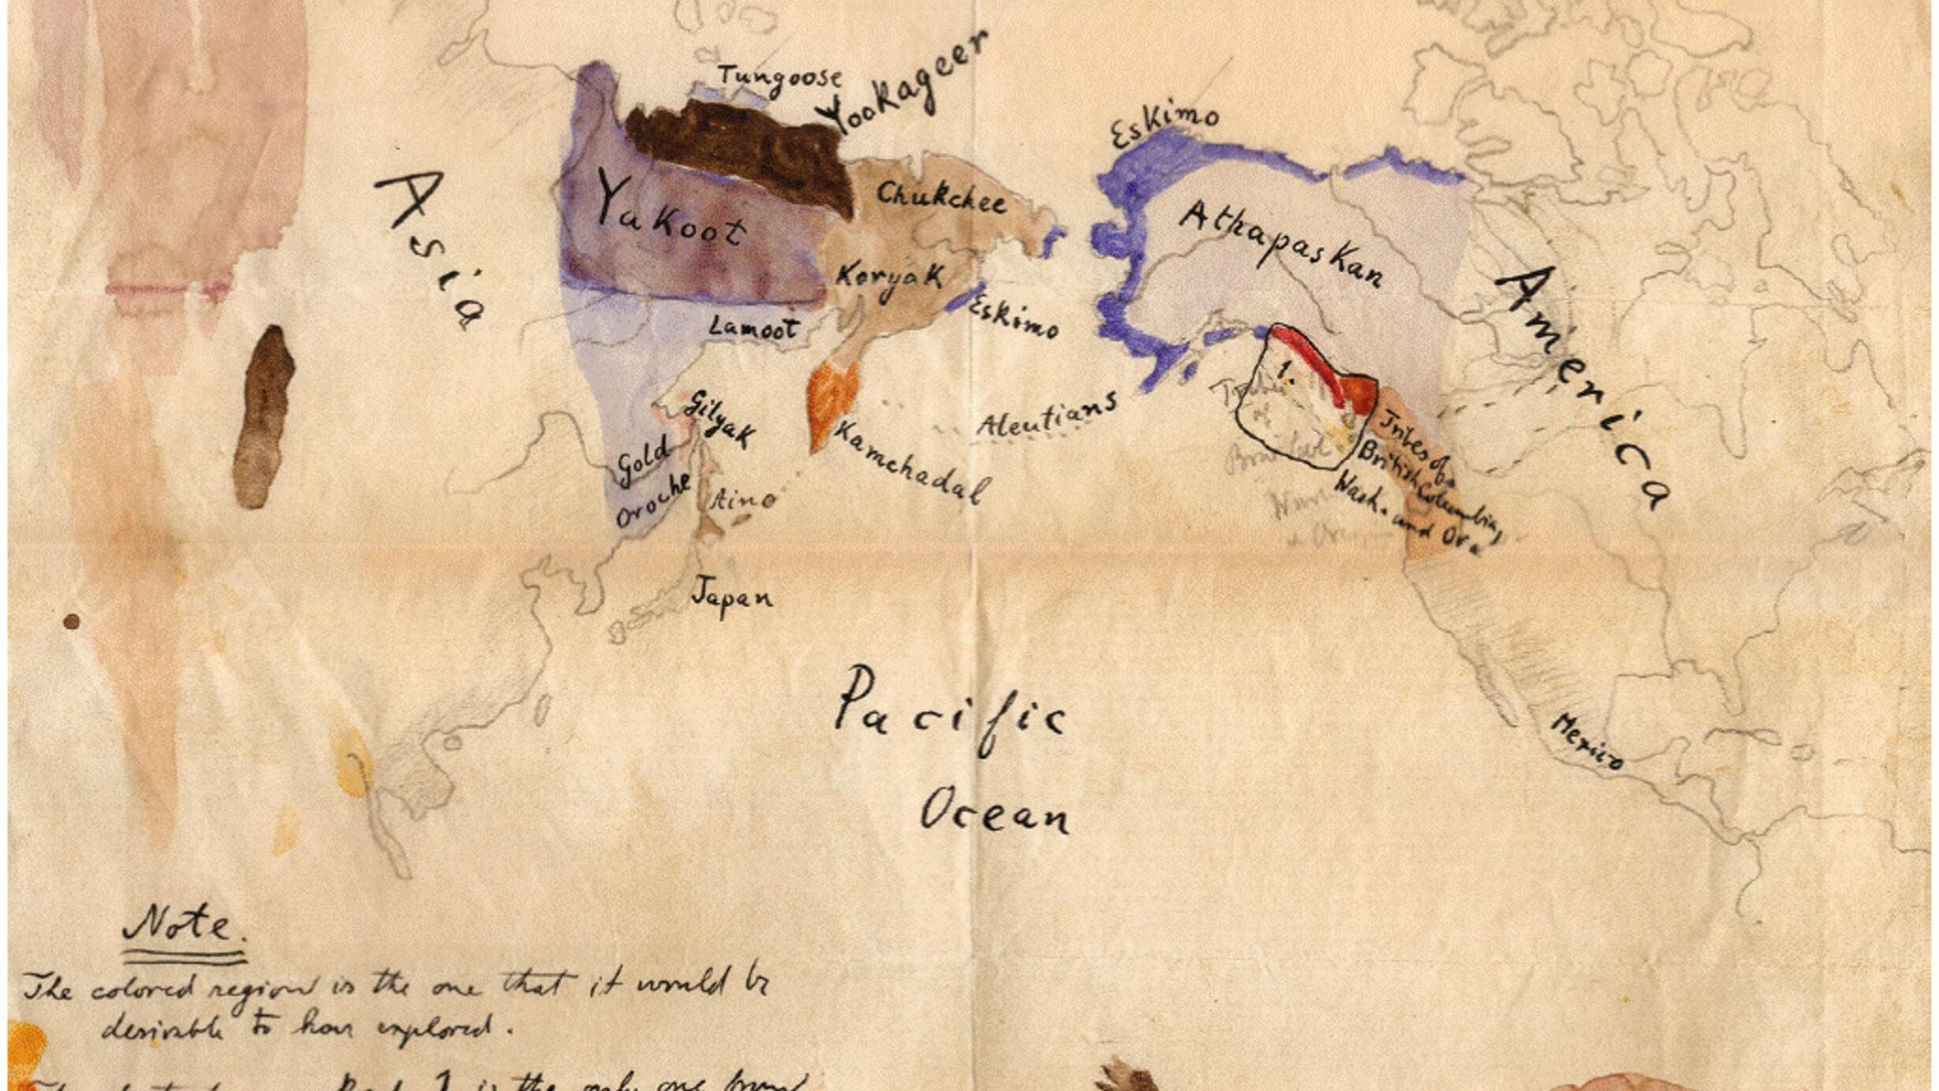
Research as a tool of colonization
Notes:
Indigenous peoples, Indigenous knowledge and Indigenous homelands have been used as a tool of colonization for centuries. From Indigenous Peoples’ perspective, “research” as practice has been linked with colonialism (Smith 1999). Historically, research conducted on Indigenous communities has often been exploitative, with researchers from dominant cultures extracting knowledge without adequately considering the perspectives and agency of Indigenous Peoples

Slide 9

Alas as a permafrost term
Permafrost Glossary
Notes:
Many western scientists utilize(d) Indigenous Knowledge in their research inappropriately (Jessen et al. 2022). History of scientiﬁc uses of the term Alaas can serve as an example of existing wrongdoings of western science-based knowledge system of human-Mother Earth relations and how Indigenous and place-based understandings of Alaas should lead future research. The term alas in permafrost terminology, typically spelled as “alass” or “alas”, refers to “a large depression of the ground surface produced by thawing of a large area (e.g.,> 1 ha) of very thick and exceedingly ice-rich permafrost”(Permafrost Glossary)

Slide 10
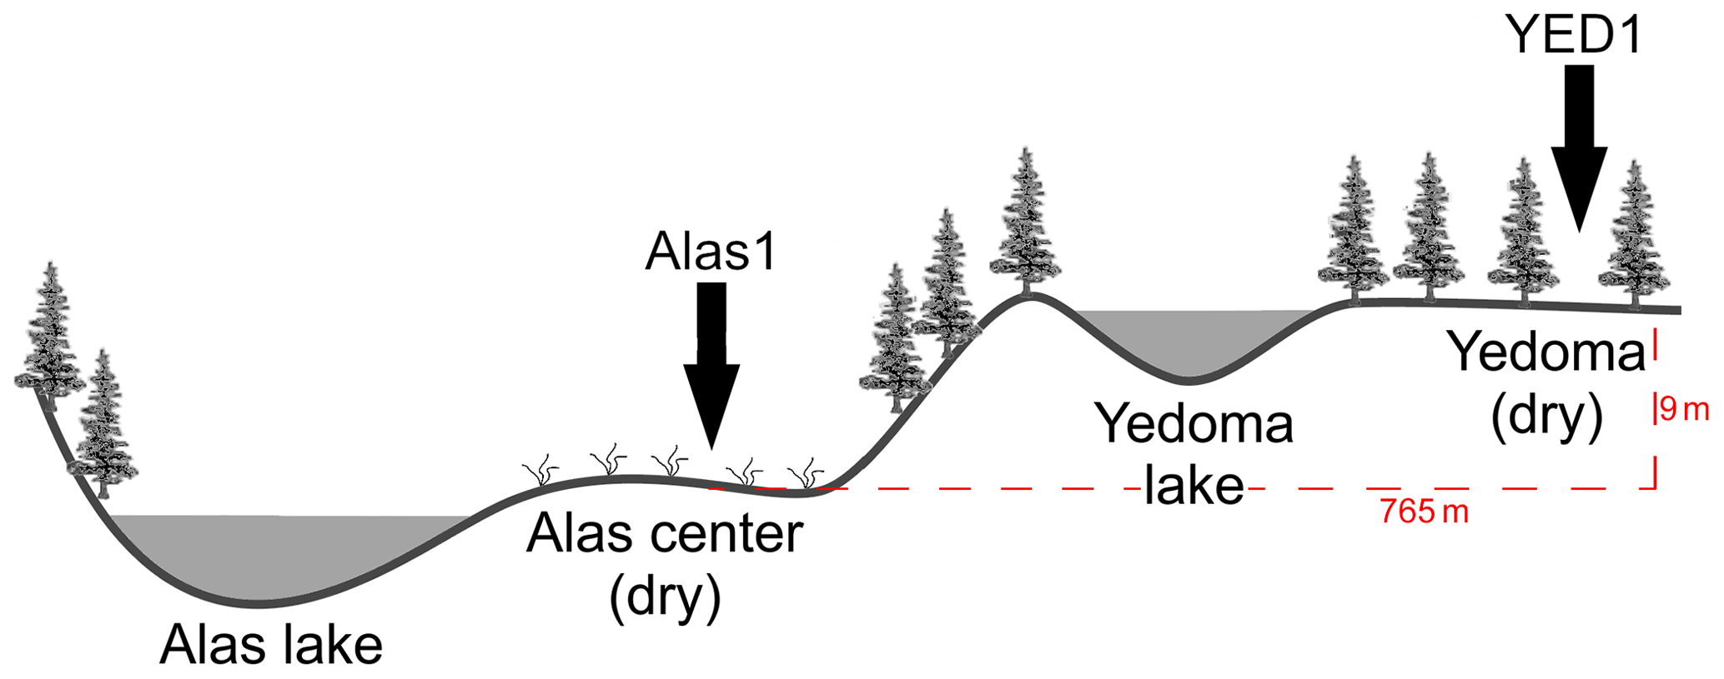
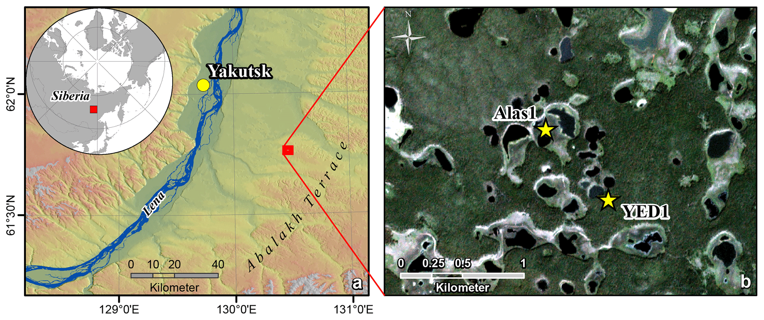
Alas as a permafrost term
Notes:
For the ﬁrst time the alas had been mentioned in Russian scientiﬁc literature by Abolin in 1929. The author used it for describing treeless depression and referenced it as a “local word,” but did not give any other details. Later in the1940s, other scientists used alas along with a few other words borrowed from the Sakha language such as byllaar, ieie, jueje, and tyympy to deﬁne the stages of the process of thermokarst(Eﬁmov and Grave 1940; Soloviev 1959, 1962). The term had been accepted and broadly used by the international scientiﬁc community since the 1970s (Czudek and Demek 1970;Soloviev 1973). The term is still broadly used and is not acknowledged to be Sakha in glossaries, vocabularies etc. This neglect deprives the scientiﬁc community from rebuilding its relationships with Indigenous knowledge systems and represents a colonial artefact that needs to be rectiﬁed

Slide 11
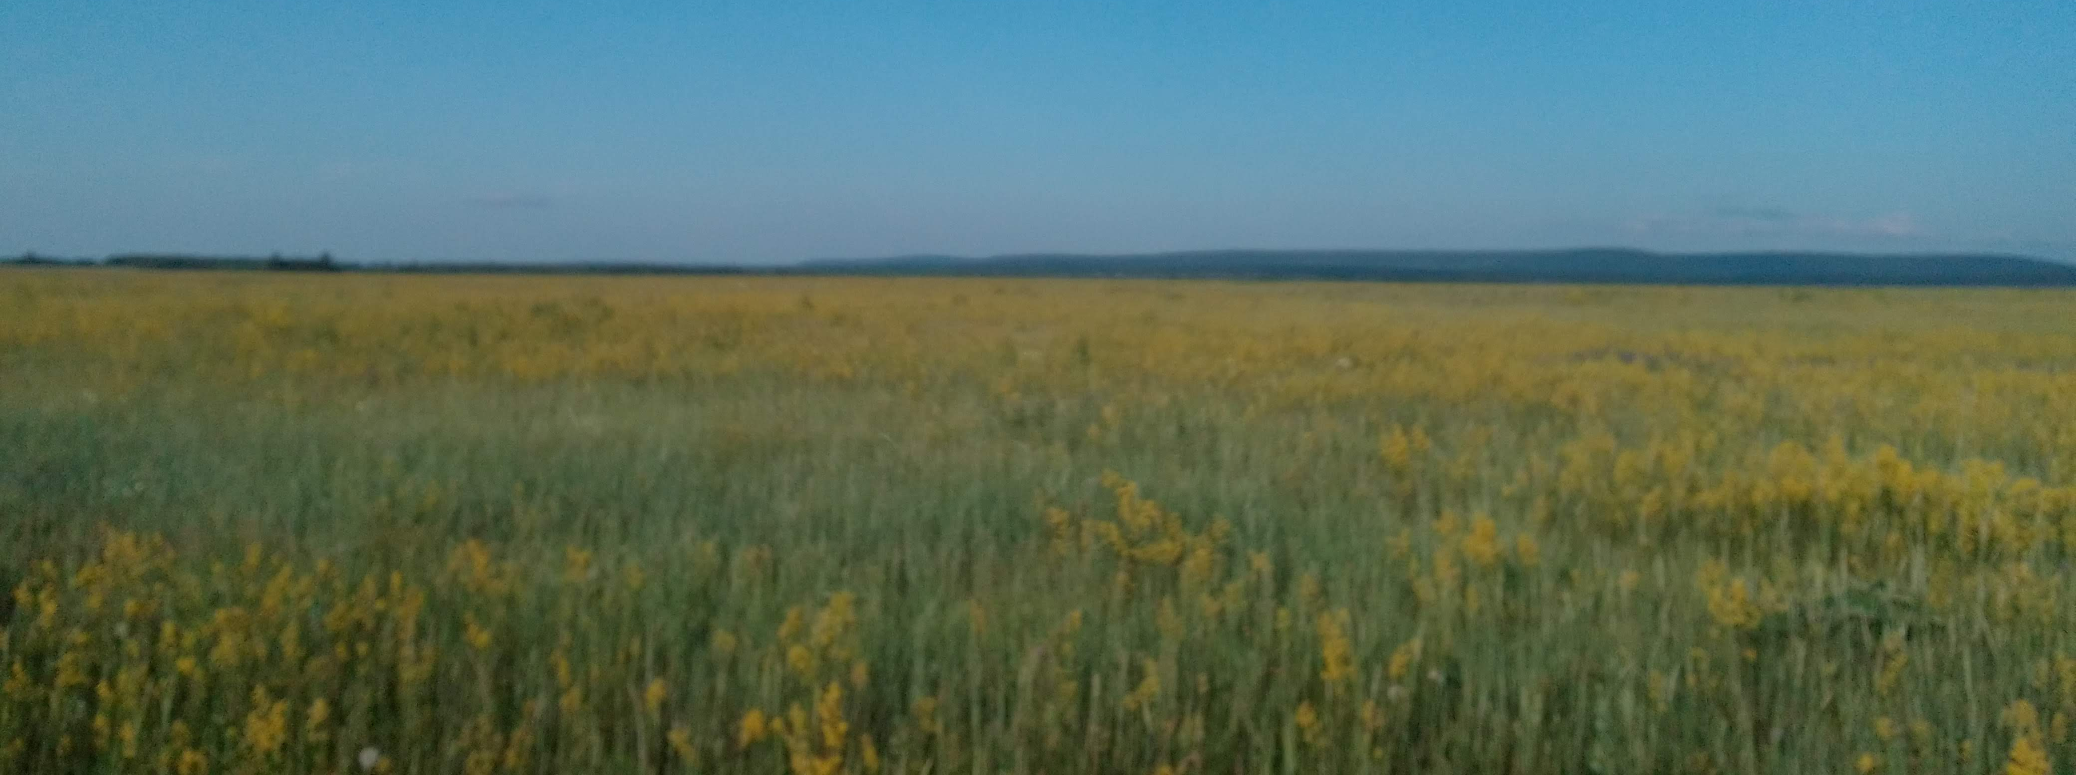
Alaas as a Sakha sacred space
Alaas is a sacred place with its name, ichchi (spirits), power, and human, more-than-human inhabitants for living, cattle, and horse breeding, ﬁshing and other traditional activities
Notes:
Alaas has always been an important traditional space for Sakha people. Traditionally, Alaas was associated with agropastoralism as it had productive hay harvesting ﬁelds and grazing grounds, which constituted key factors for Sakha cattle breeders (Djachkovsky and Popova 2014). Alaas presents a highly productive ecosystem and a source of forage for horse and cattle (Crate et al. 2017; Fig. 2).Horse and cattle breeding are traditional subsistence economies for Sakha people which provide food, transportation, clothing, social and cultural well-being, identity as well as income (Maj 2009). Moreover, Alaas is a living space for ﬁshing, hunting and gathering which also present an important traditional practice for Sakha people. Sakha people have been cattle and horse breeders for centuries, and, therefore, Alaas as a hay harvesting and grazing ﬁeld played an important role in Sakha livelihoods. However, Alaas was not only a utilitarian place but also, and most importantly, a spiritual and sacred space with ichchi (spirits), more-than-human beings, animate and inanimate.

Slide 12
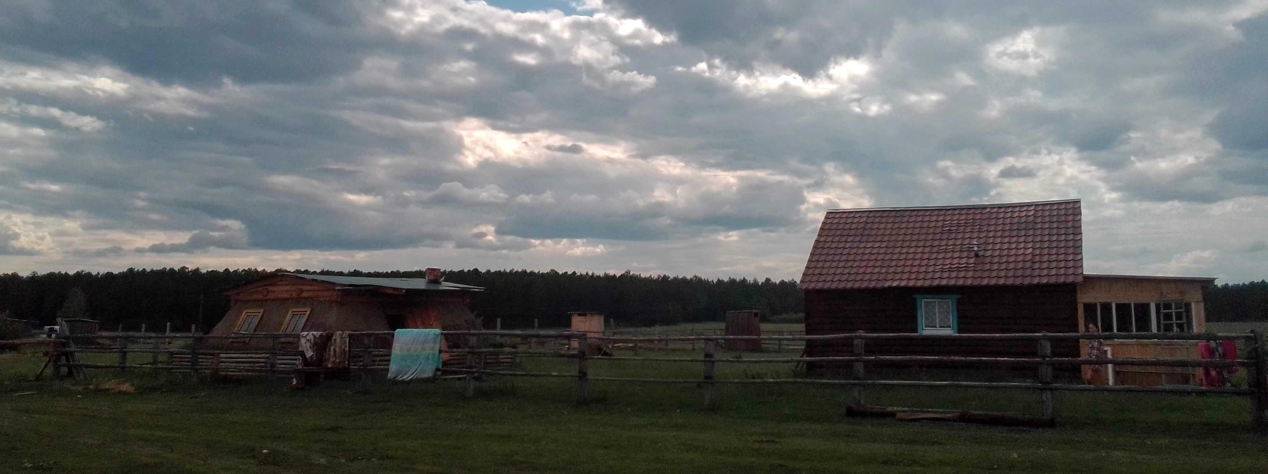
Alaas as a Sakha sacred space
Alaas nowadays is a cultural, spiritual and identity (re)construction space in the contemporary context of climate change, market economy, urbanization and globalization.
Notes:
Cattle and horse breeding is continuing to decline these days due to climate change and high expenses (Solovieva 2021; Ksenofontov and Petrov 2024). Hay harvesting ﬁelds are often times water-logged as a result of permafrost thaw and many households discontinue practicing cattle breeding (Crate 2018). Therefore, Alaas may have lost its previous practical and economic meaning and tends to be used largely as a cultural, spiritual, and identity reconstruction space in the contemporary context of climate change, market economy, urbanization, and globalization.

Slide 13
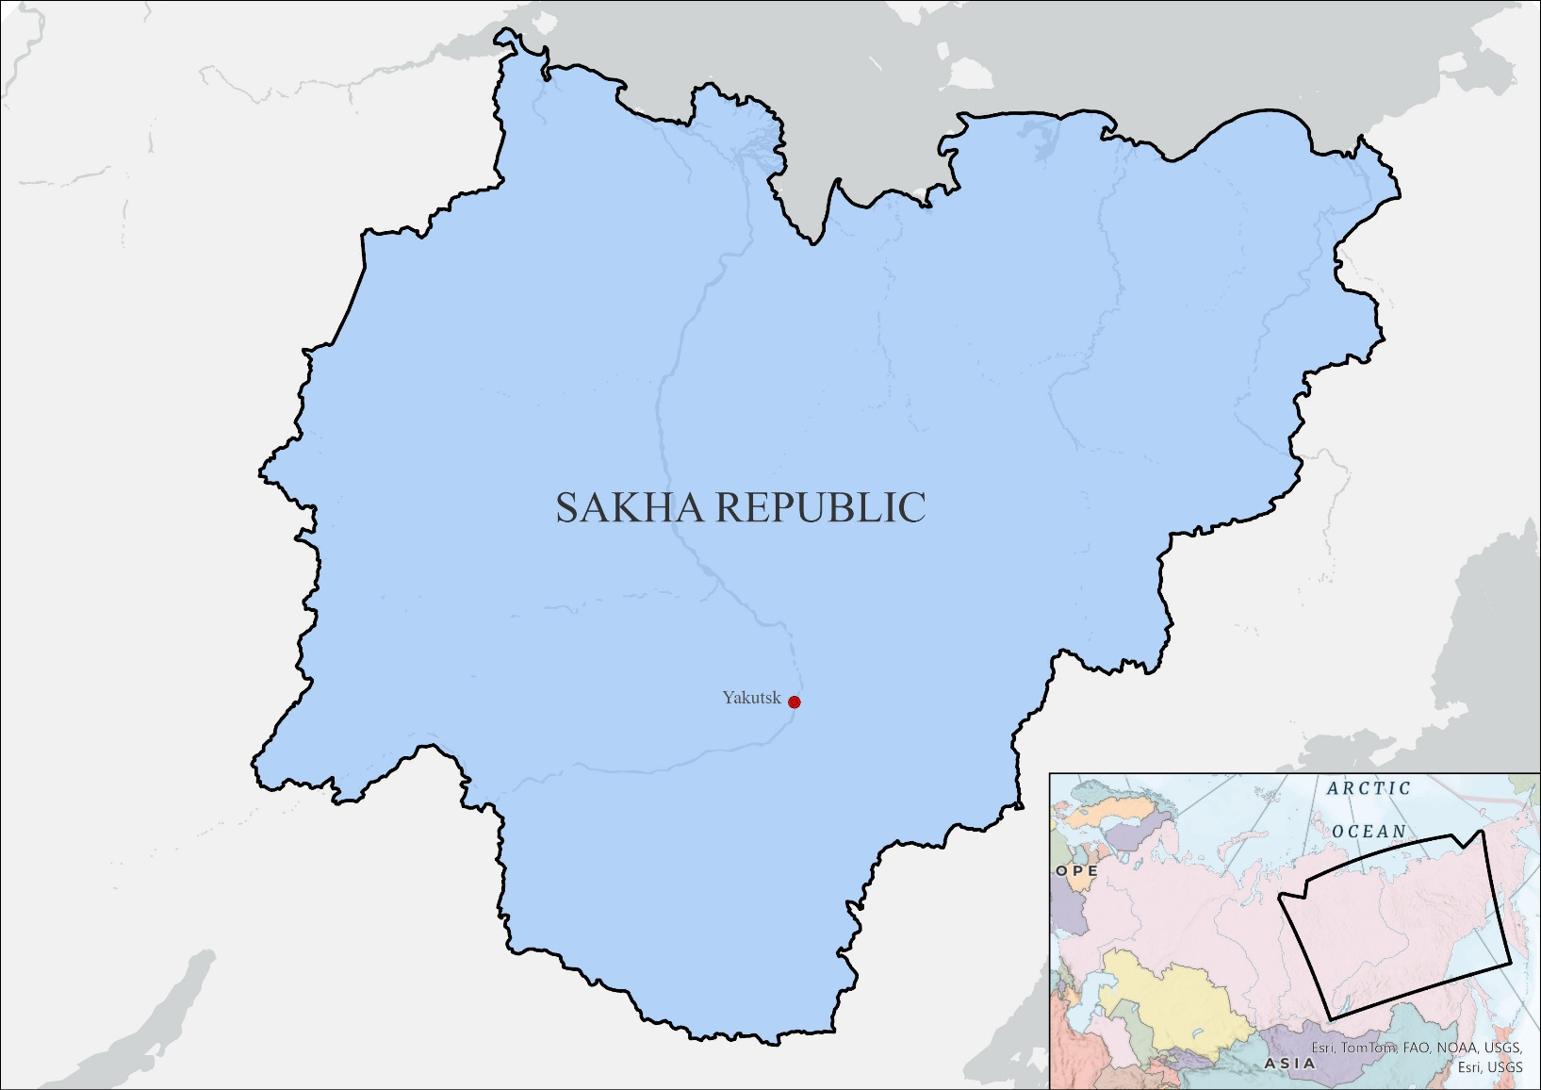
Sakha Sire
Map by S.Drozdetsky
Notes:
The research is based in Sakha Sire as we call our homeland or Sakha Republic as it is called officially. It is located in NE Siberia, and it is the largest province in Russia with a territory of 3 mln sq km. However, the population is scarce with only 1 million people half of whom are Indigenous. Chukchi, Evenki, Eveny, Dolgans, Sakha and Yukaghirs are Indigenous groups who inhabit our region, and Sakha being the largest one.

Slide 14
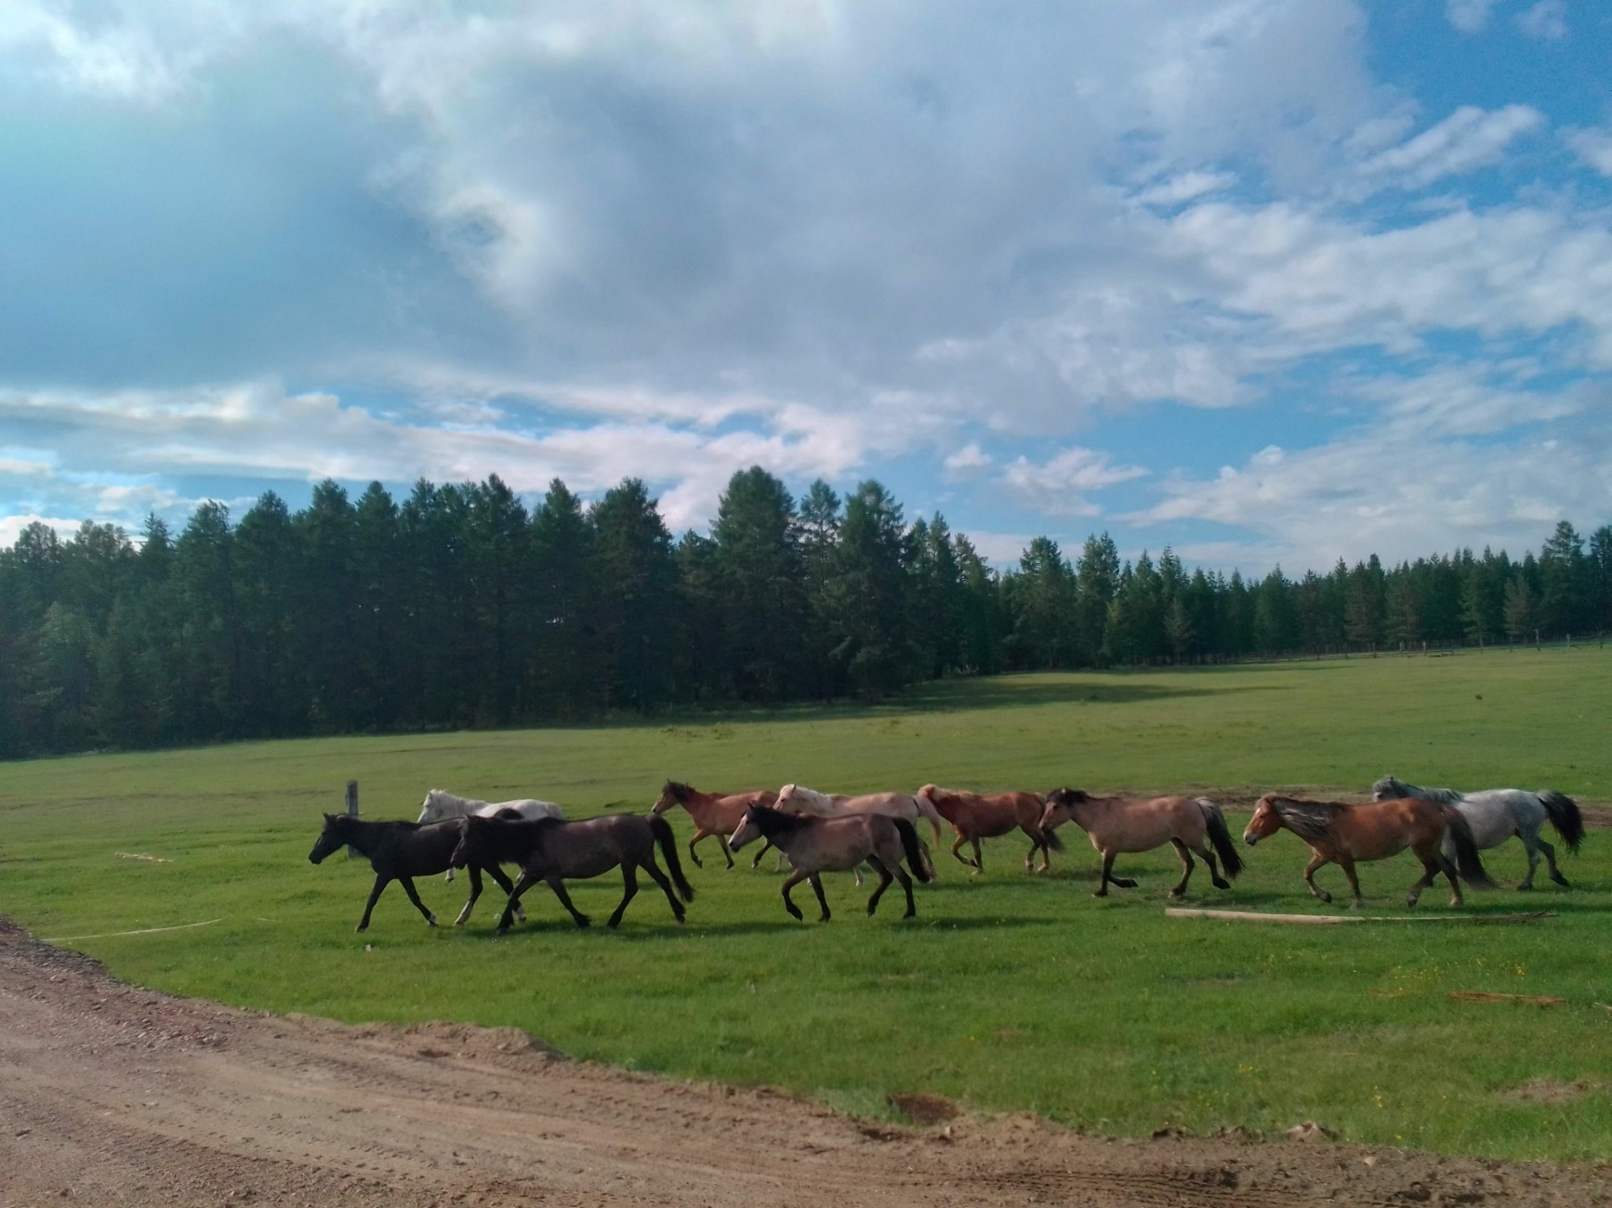
Sakha Sire
Notes:
Horse is one of the main inhabitans of Alaas. A horse is an important relative for us which helps us in our livelihoods as a food, transportation, clothes, medicine, cultural and spiritual well-being.
Sometimes we call ourselves “Johogoi ogholoro” which means children of the horse where Johogoi is a horse. It is one of the major deities to which we pray and we call it “Johogoi Aiyy”.

Slide 15
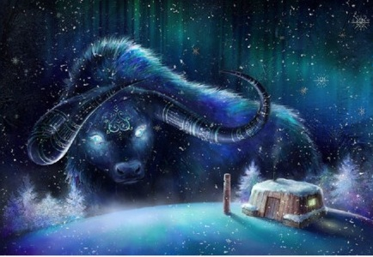
Sakha Sire
Notes:
The bull is also a spiritual animal to live in Alaas. Jyl Oghuha (the Bull of winter) is a personified white bull with blue spots, big horns and cold breath who arrives at Sakha Sire in early December and holds cold temperatures until late February. It is believed that with the bull's each horn and head's loss the warm spring advents closer. Therefore, Alaas is located in the centre of Sakha livelihoods and cosmologies.

Slide 16
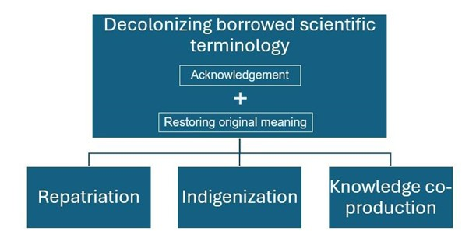
Pathways to decolonize
Notes:
To decolonize borrowed Indigenous terms for the sake of science western scientists need to acknowledge that scientiﬁc appropriation took place and recognize and possibly restore the original meaning of those terms. We suggest three pathways of decolonization of such borrowed terminologies. The western science must ﬁrst acknowledge the origin and cultural meaning of the term borrowed. Acknowledgement could be followed by three pathways of decolonization. Repatriation of intangible Indigenous knowledge to communities when Indigenous terms, cultures, and ontologies must be acknowledged and returned. The second path is Indigenization or reconceptualization of Indigenous terms using original meanings. A decolonial idea would consist in adding more information about Alaas to the existing permafrost vocabulary and glossary to emphasize the sacred meaning of Alaas. And ﬁnally, the third path is the co-production of shared meanings, i.e., co-development of new meanings that result from the knowledge co-creation process between Indigenous knowledge and Western science. An Indigenous term of Alaas may be explained scientiﬁcally while keeping its sacred and spiritual meaning.

Slide 17

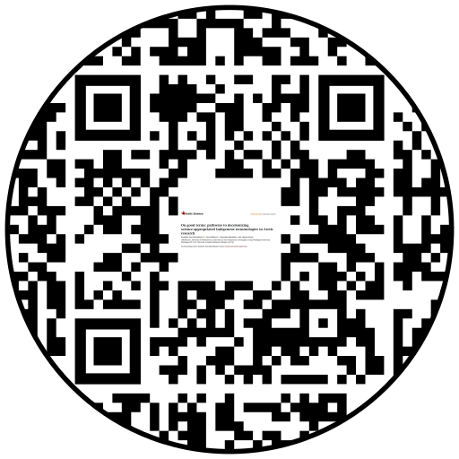
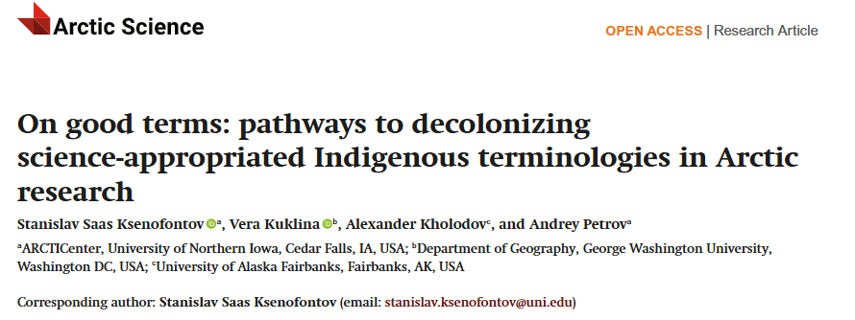
Makhtal!
Thank you!
This research was funded by National Science Foundation, research project “Frozen Commons” grant number 2127345

