Slide 1
Mobilizing different forms of media for knowledge sharing: experience from
Frozen Commons
Arctic Day
Denis Dabaev

Slide 2
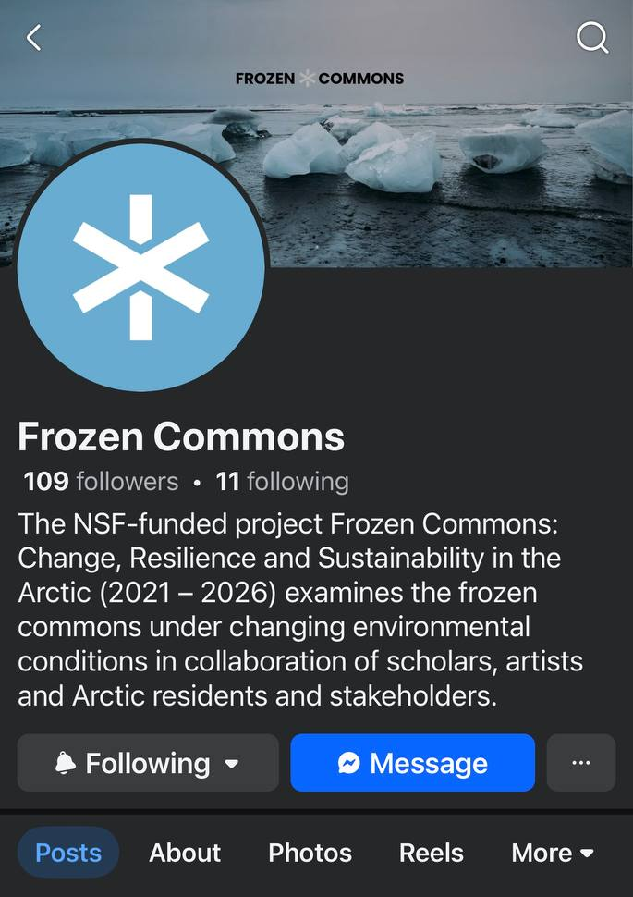
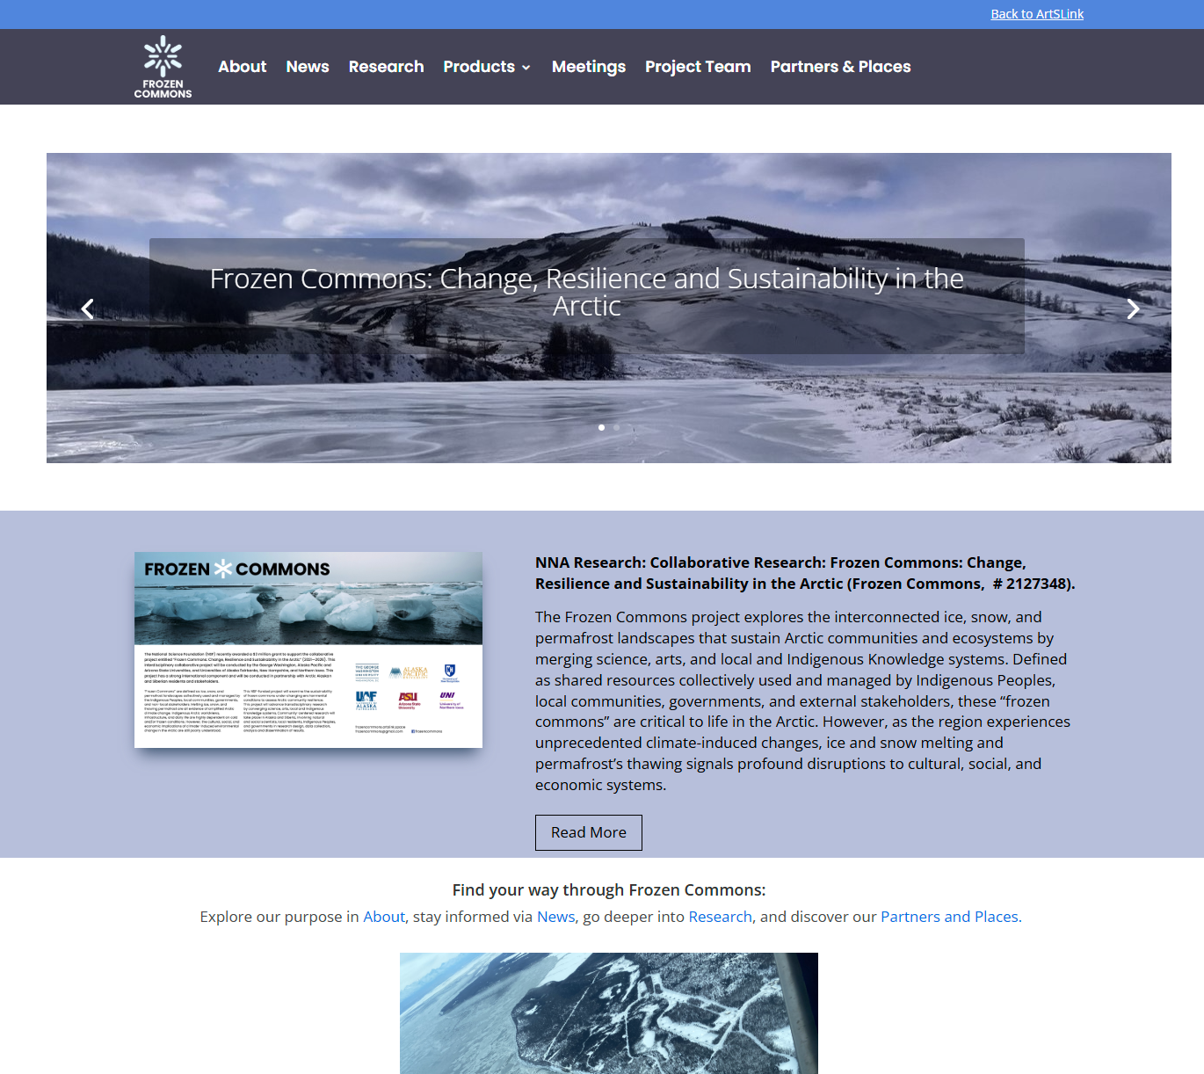
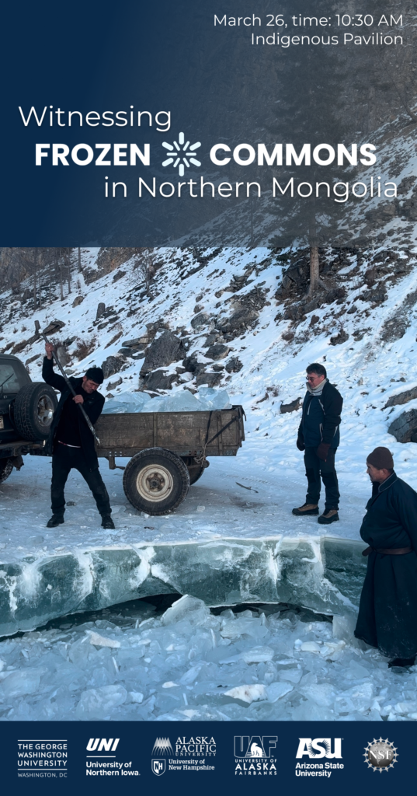
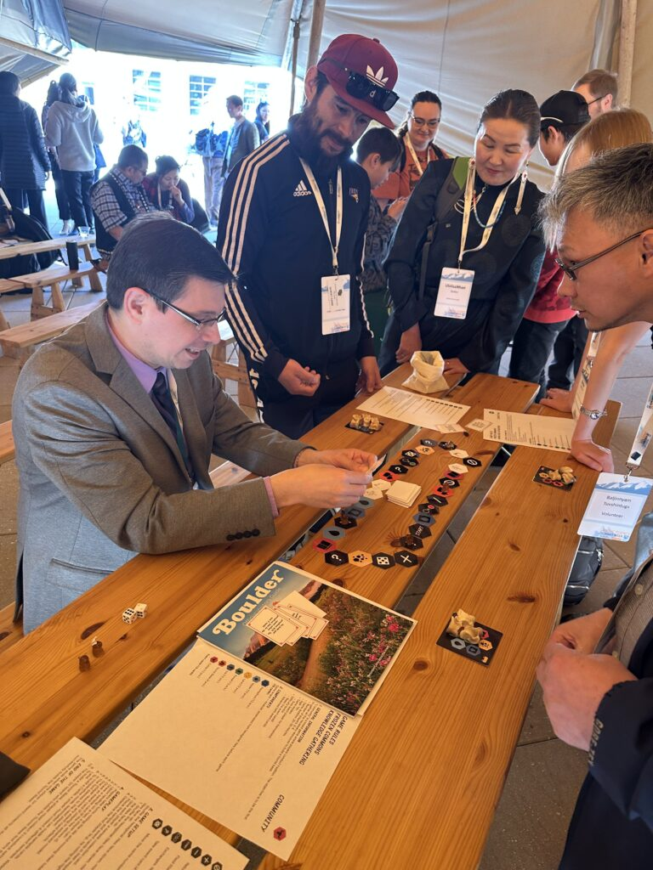
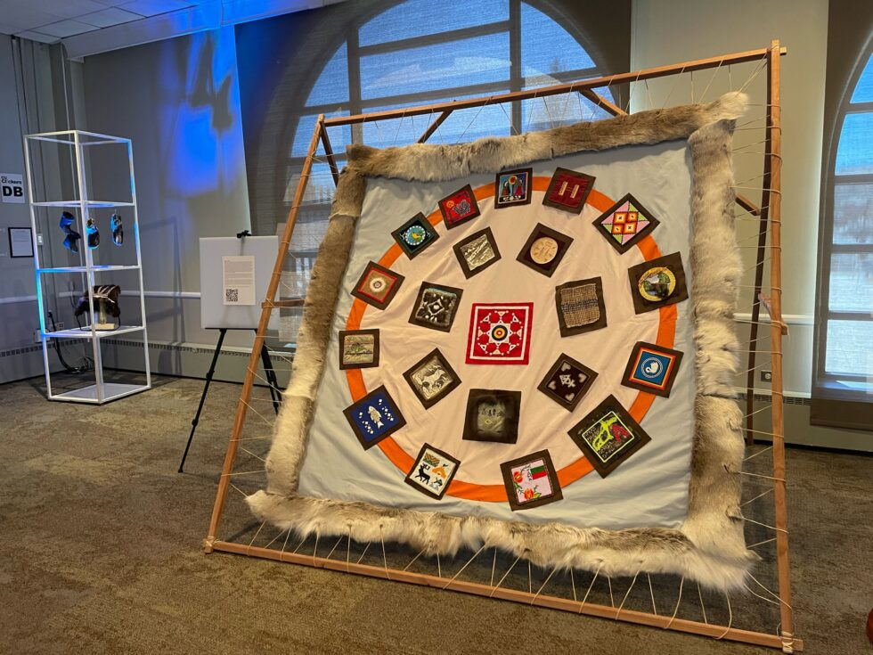
Media

Slide 3
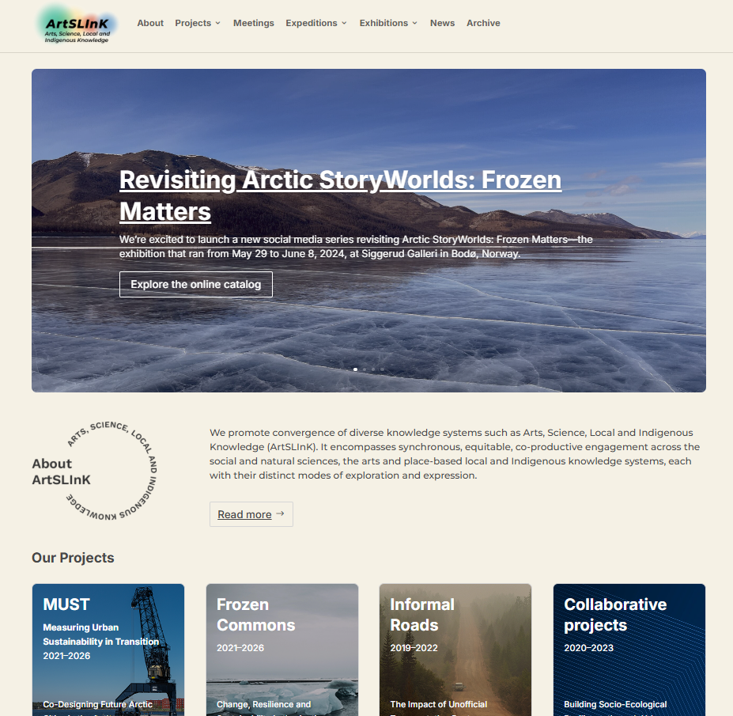
ArtSLink
Science Presentation
We develop ArtSLInK portal, which presents all the projects released by team members. Here we publish news about upcoming events, past exhibitions, conferences, field research, and other work done by our team.
Link

Slide 4
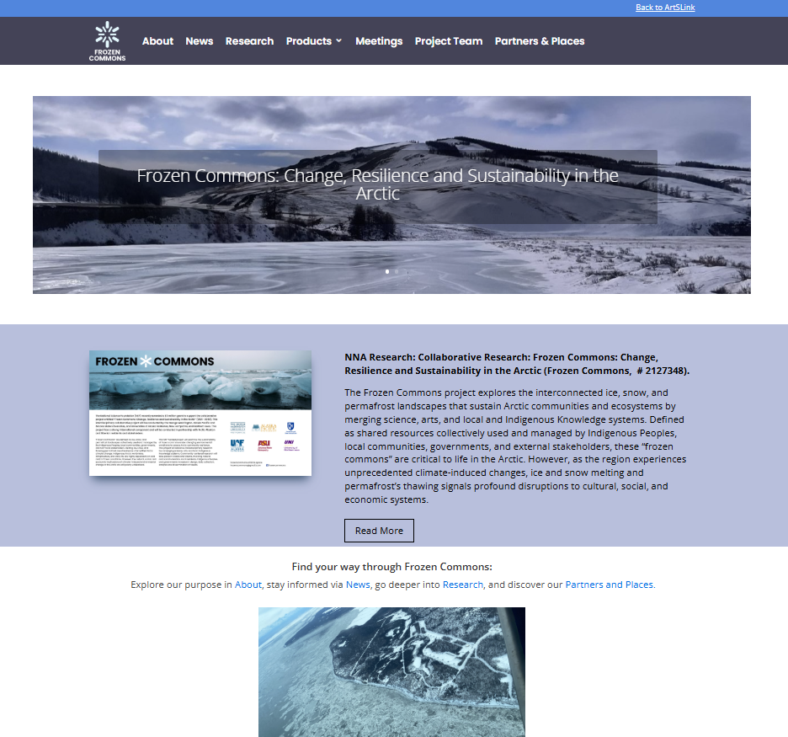
Frozen Commons
Science Presentation
Frozen Commons is part of the Artslink initiative. I worked on developing the website for Frozen Commons, which shows the work done by the Frozen Commons Team.
Link

Slide 5
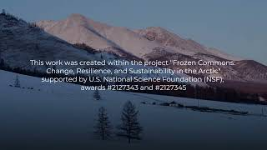
Witnessing Frozen Commons in Northern Mongolia

Slide 6
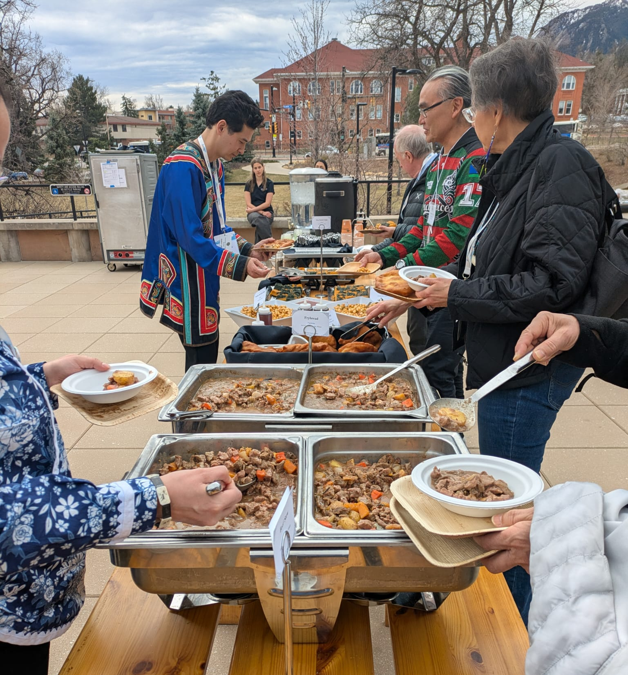
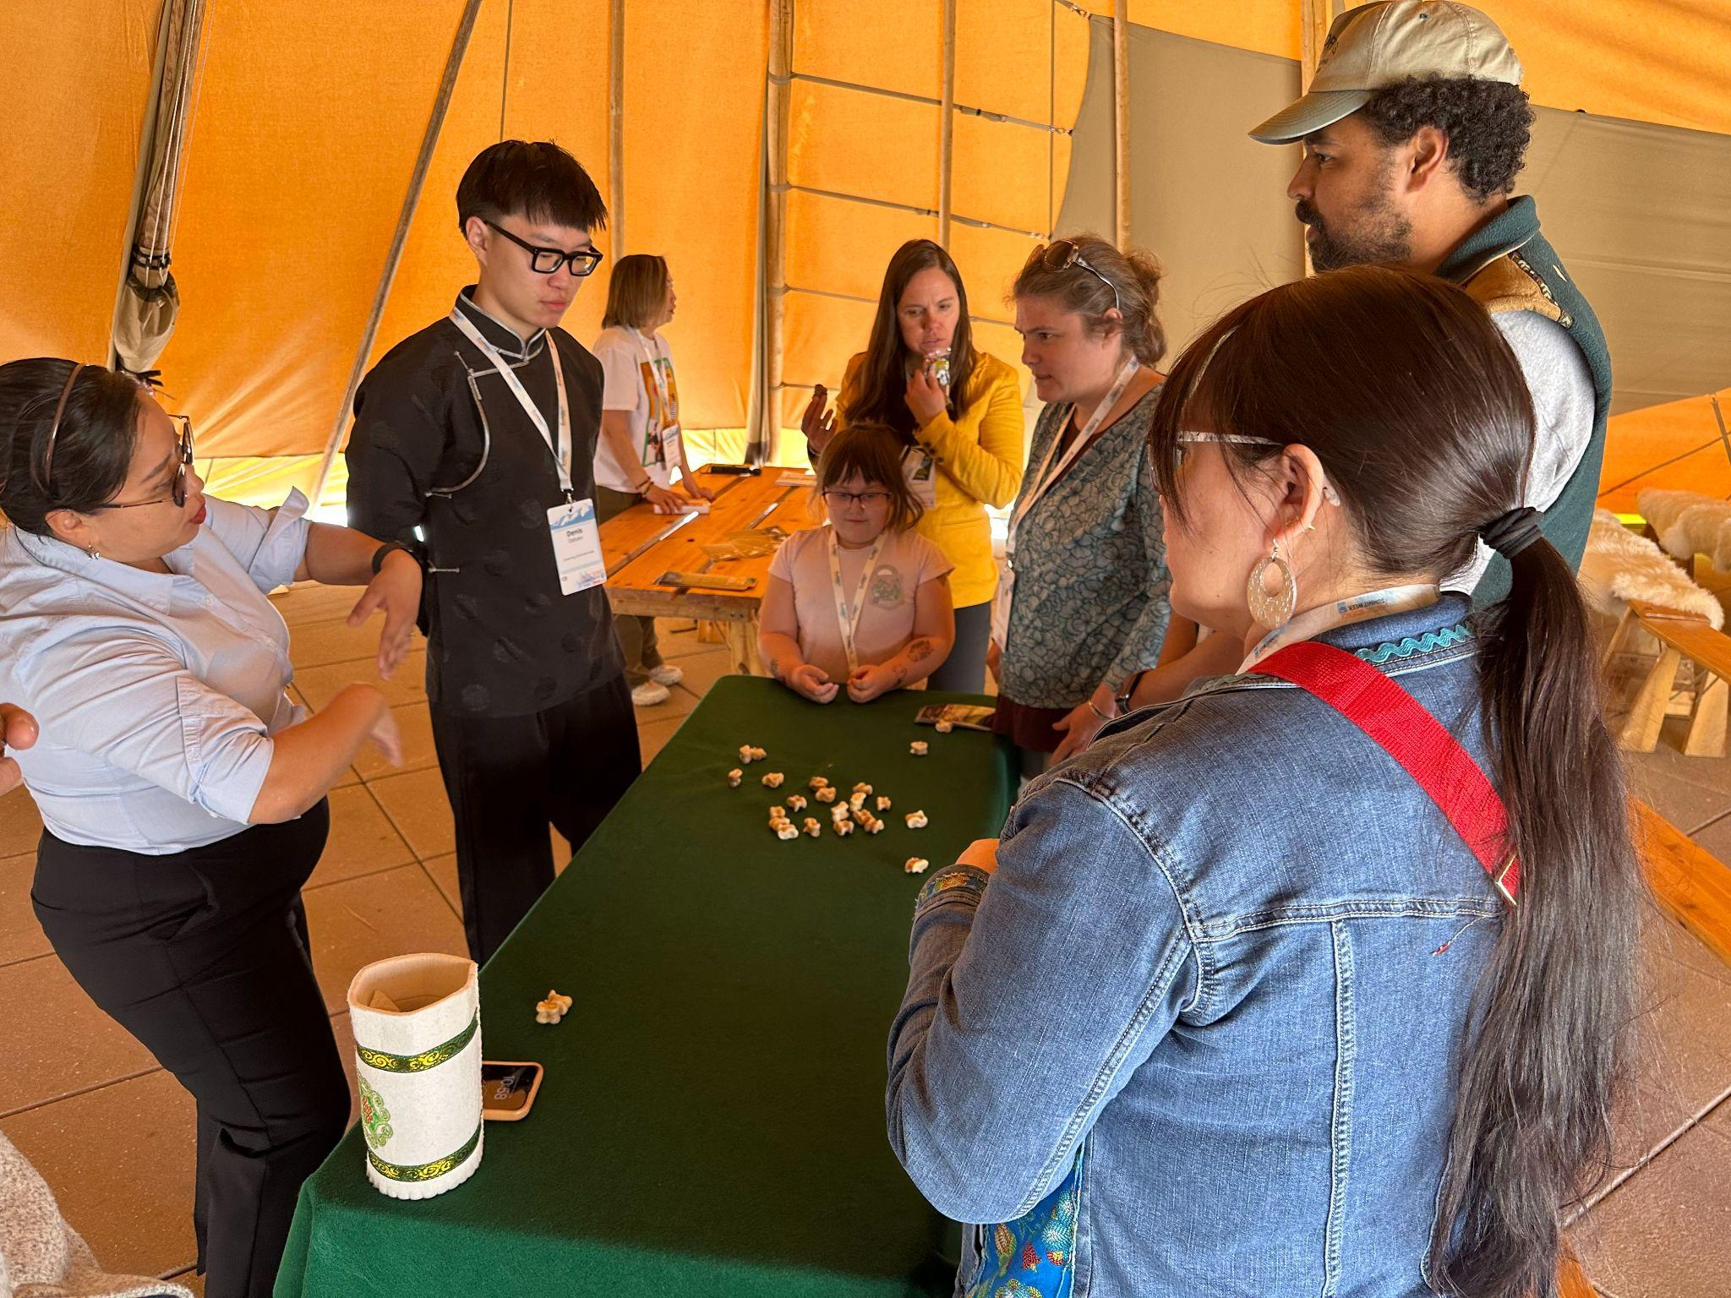
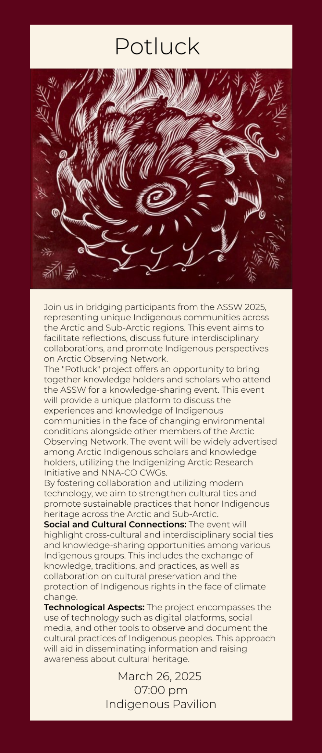
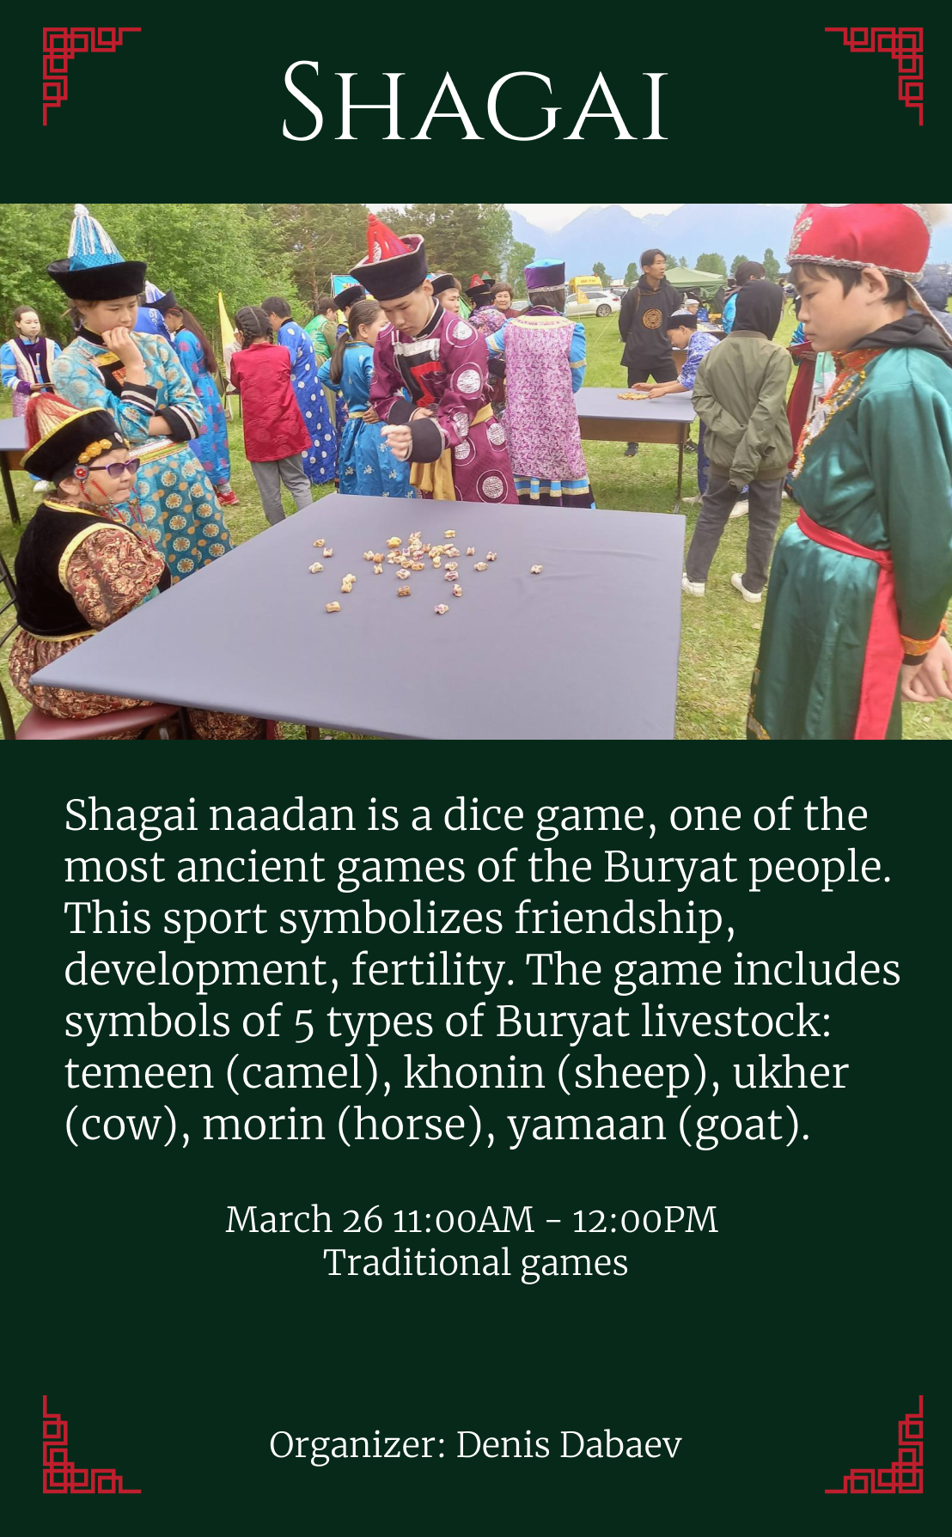
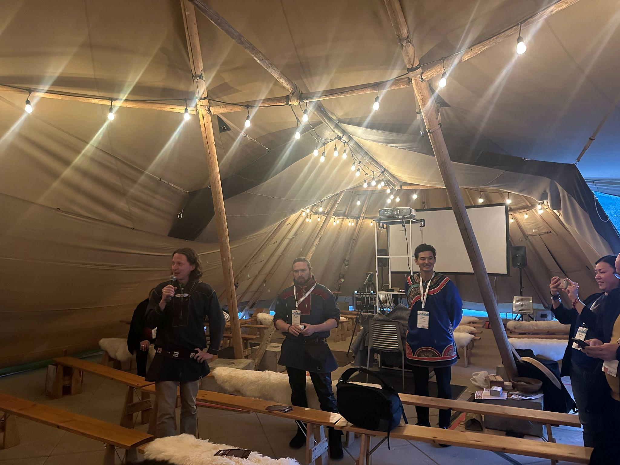

Slide 7
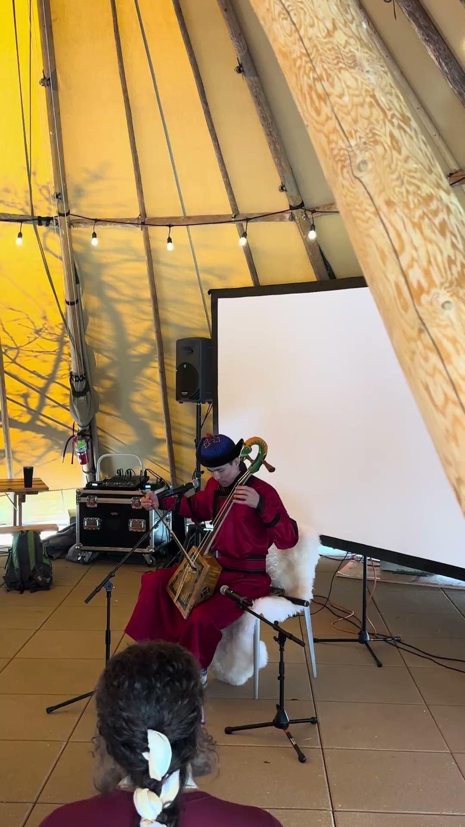
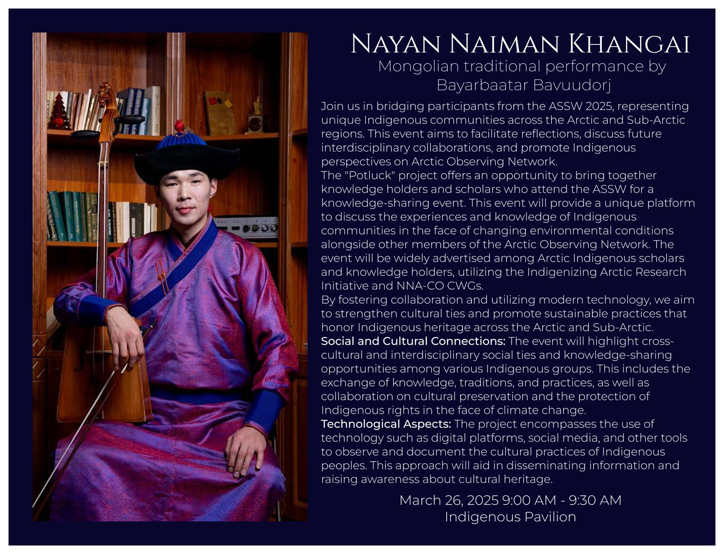

Slide 8
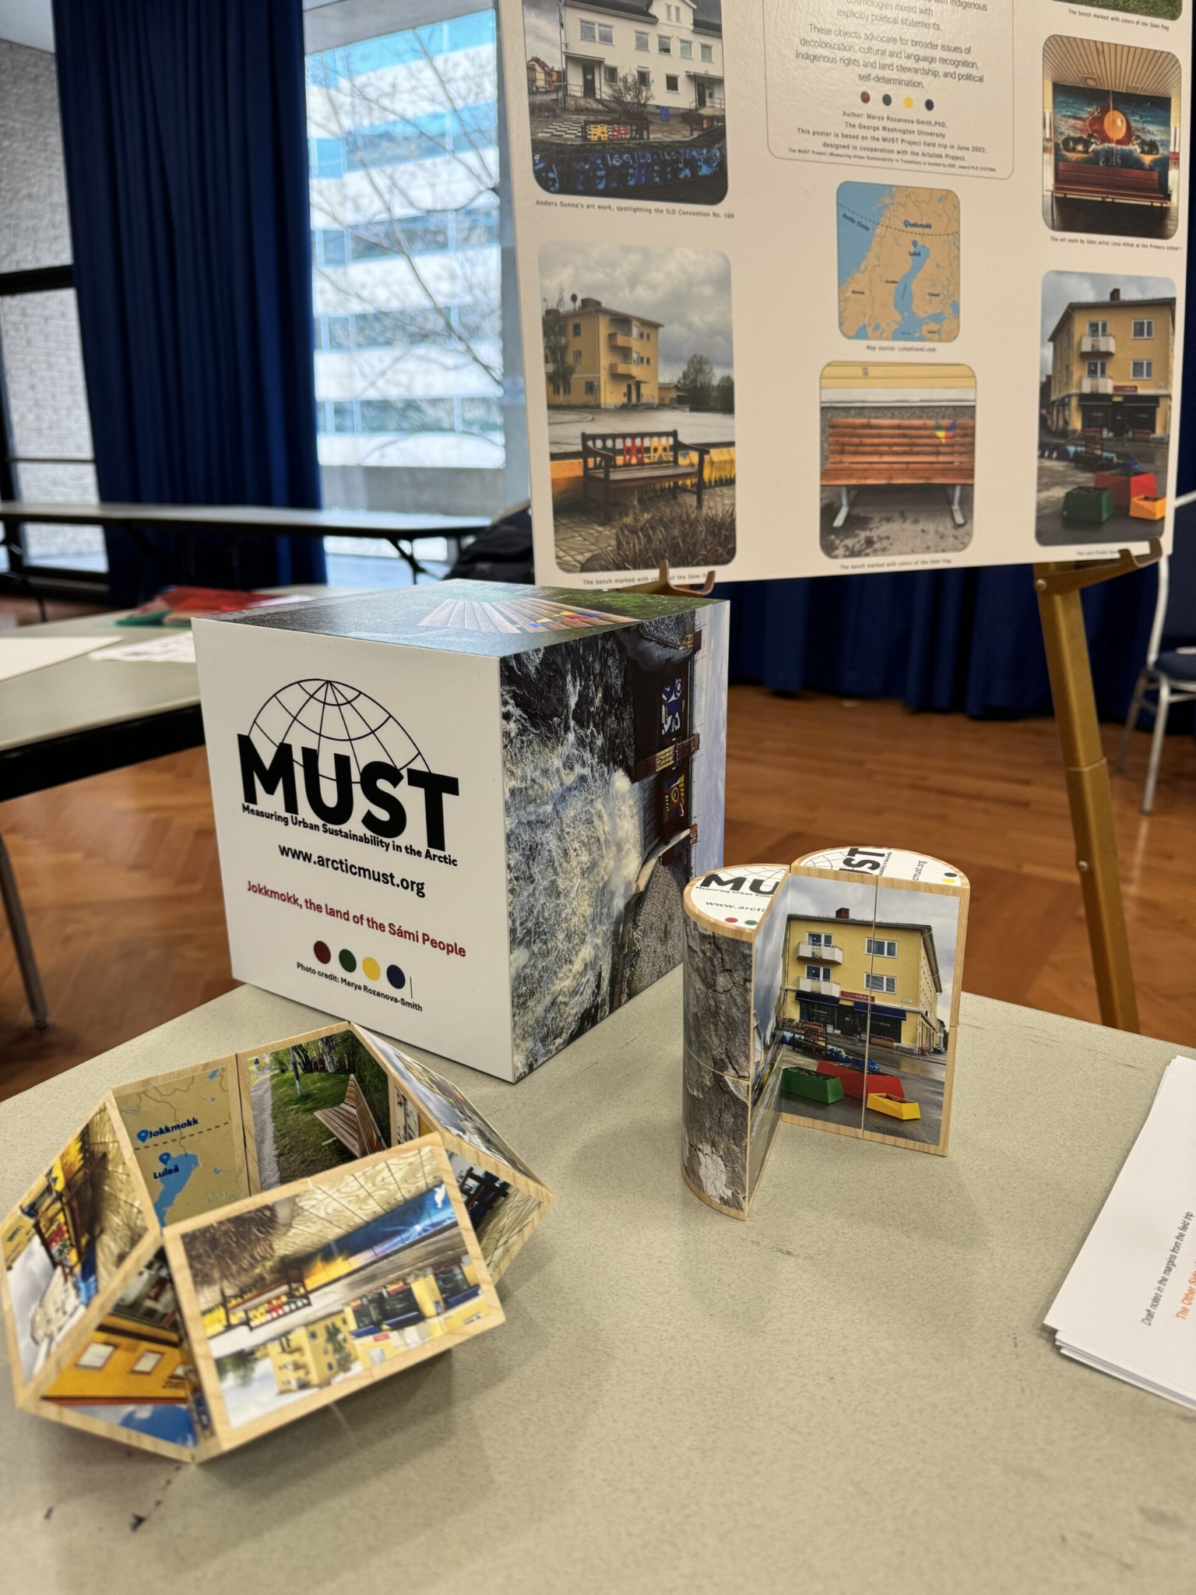
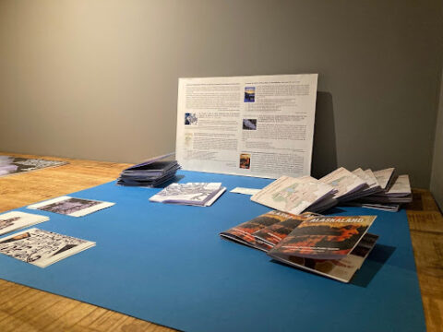
Zins
Zins can be created by scientists for reflections and immediate impressions to be captured about research and shared with communities for building relations and understandings.

Slide 9
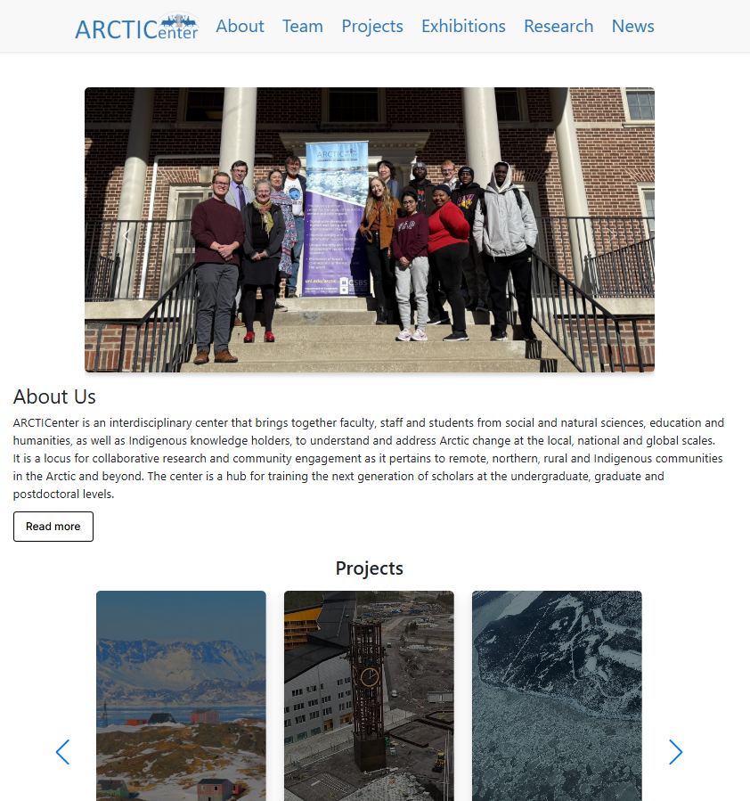
ARCTICenter
Science Presentation
In the fall, ARCTICenter launched its new website, which was developed using Django, a Python framework. Here you can find information about our center and the projects our team is working on.
Link

